Slide 1


GROOVING MACHINE 02 MANUAL
Project Description : Grooving Machine 02 Hydraulic to Servo
Customer Name :Maadhav Automotive Fasteners Pvt. Ltd.
Order Number : NA
Order Date :15/03/2024
Developed By:
MAINTICS AUTOMATION & ROBOTICS LLP
Email : contact@maintics.com
Phone: +91 7042626619
Website : www.maintics.com

Slide 2
GROOVING MACHINE 02 MANUAL
Project Description : Grooving Machine 02 Hydraulic to Servo
Customer Name :Maadhav Automotive Fasteners Pvt. Ltd.
Order Number : NA
Order Date :15/03/2024
© MAINTICS AUTOMATION & ROBOTICS LLP

Slide 3
Table Of Contents
Operation Manual
Electrical Drawing
Troubleshooting Guide
BOM (Bill of Material)

Slide 4
Operation Manual

Slide 5

Company Profile Screen
At first when you turn on the Machine this screen will open.
This is the Company Introduction screen.
Click anywhere in the screen to navigate on Main Menu

Slide 6
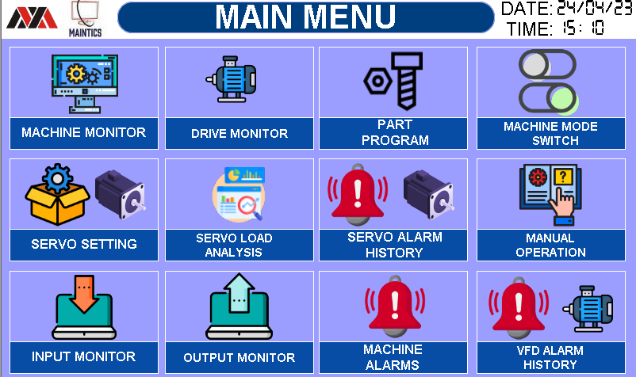
1. MAIN MENU SCREEN
This Screen is for Navigation inside the HMI of below screens.
Below are the list of all available screen in the HMI.
MACHINE MONITOR
DRIVE MONITOR
PART PROGRAM
MACHINE MODE SWITCH
SERVO SETTING
SERVO LOAD ANALYSIS
SERVO ALARM HISTORY
MANUAL OPERATION
INPUT MONITOR
OUTPUT MONITOR
MACHINE ALARMS
VFD ALARMS HISTORY

Slide 7
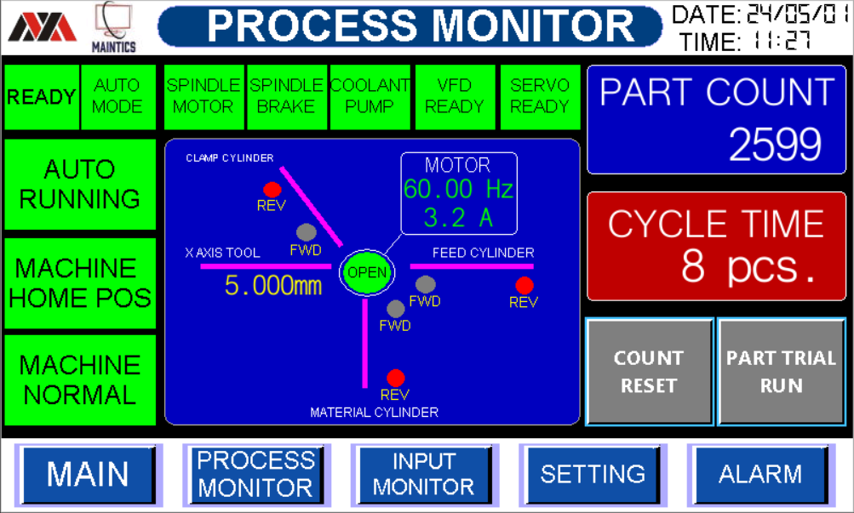












2. PROCESS MONITOR SCREEN
This screen is to Monitor Whole machine at Single Place
Machine Ready Status
Machine Auto / Manual Mode Status
Machine Auto Running Status
Device Running Status
Home Position Indication and Fault Indication
Not Ready
Ready
Manual Mode
Auto Mode
Machine Stopped
Auto Running
Device OFF
Device Running
Not at Home
Machine at Home
Normal
Fault

Slide 8
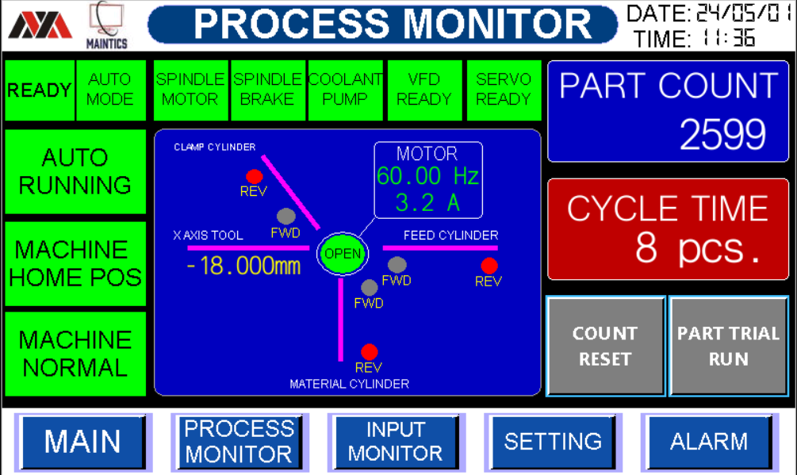


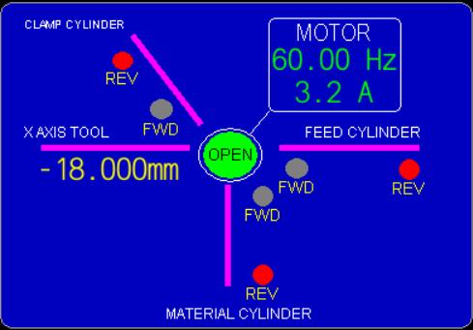
2. PROCESS MONITOR SCREEN
This screen is to Monitor Whole machine at Single Place
6. Total Parts count Cumulative and Cycle time Parts/min.
7. Machine Inputs Monitoring (Cylinder Reed switch)
8. Navigation Bar
Here you can monitor all reed switch condition On or Off.
Feed Cylinder
Material Cylinder
Clamp Cylinder
X Axis Cylinder
Y Axis Cylinder
SPINDLE MOTOR STATUS
Used to easily navigate from one screen to another screen

Slide 9
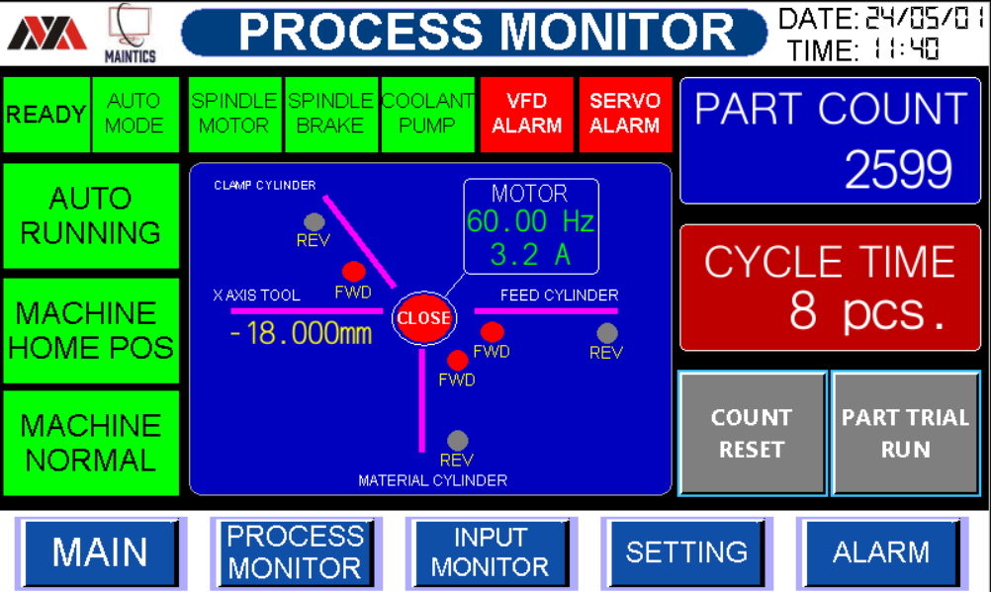





2. PROCESS MONITOR SCREEN
This screen is used to Machine Monitor current alarms & Status
1. Servo & VFD Alarm Status
Servo & VFD Alarm ON SERVO & VFD Is Ready to Use
2. COUNTER RESET & PART TRIAL RUN Status
Counter Reset Buttion is ON
Part triali Buttion is ON
Here you can Press
PART COUNTER RESET ON
Here you can Press PART TRIAL is ON

Slide 10
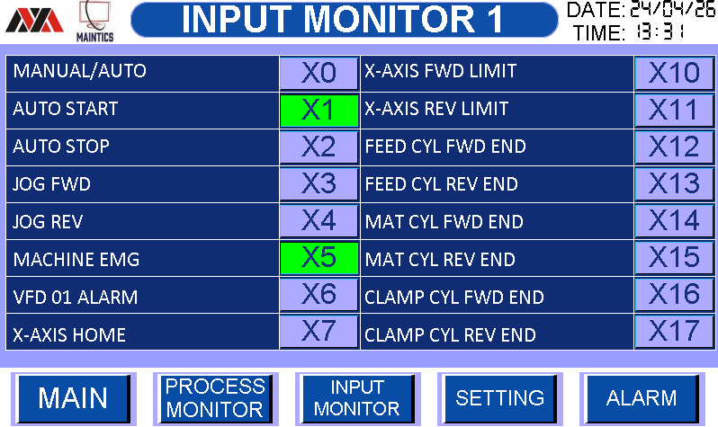



3.INPUT MONITOR SCREEN
This screen is to monitor all PLC Inputs total 16 Nos.
1. All inputs status from Off to On is as below
INPUT OFF
INPUT ON
MACHINE EMARGENCY PRESSED
MACHINE EMARGENCY NOT PRRESSED

Slide 11
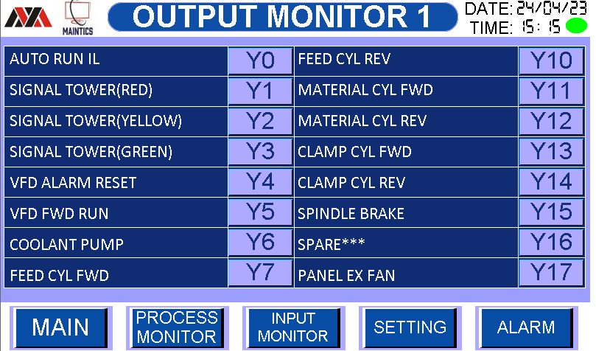


4. OUTPUT MONITOR SCREEN
This screen is to monitor all PLC Outputs total 16Nos.
1. All Output status from Off to On is as below
OFF
ON

Slide 12
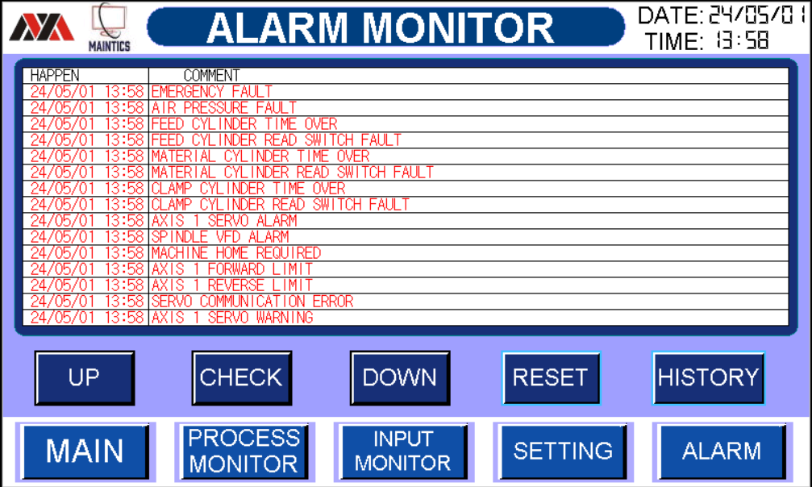



5. ALARM MONITOR SCREEN
This screen is used to monitor machine current alarms
Alarm screen navigation buttons
Reset button to reset current Alarms
Alarm History Screen access Button

Slide 13
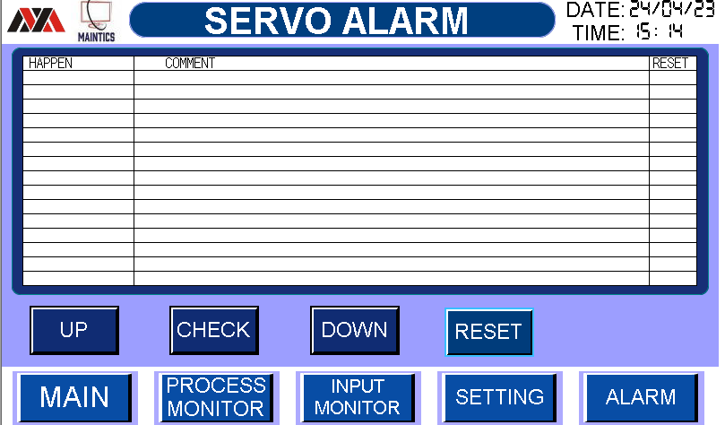
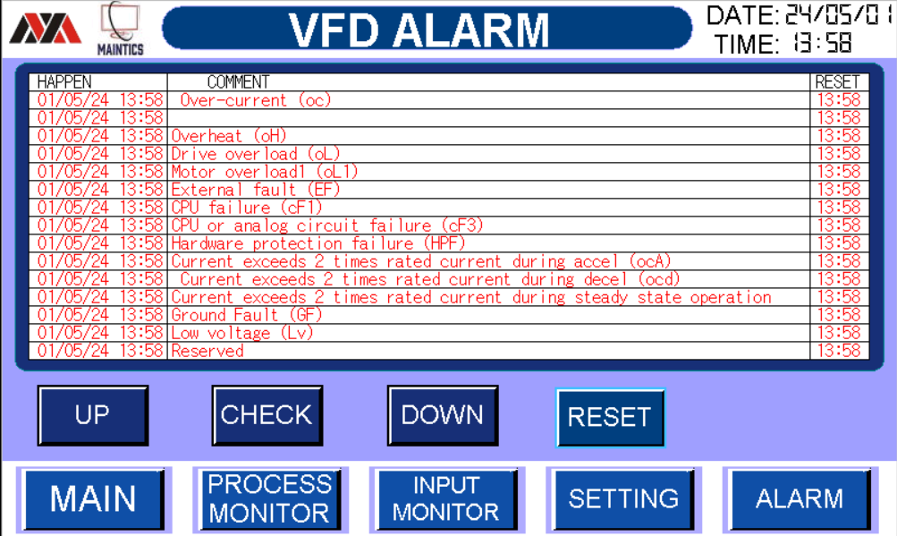
5. ALARM HISTORY SCREEN
This screen is used to monitor machine current alarms
Alarm screen navigation buttons
Reset button to reset current Alarms
Alarm History Screen access Button

Slide 14
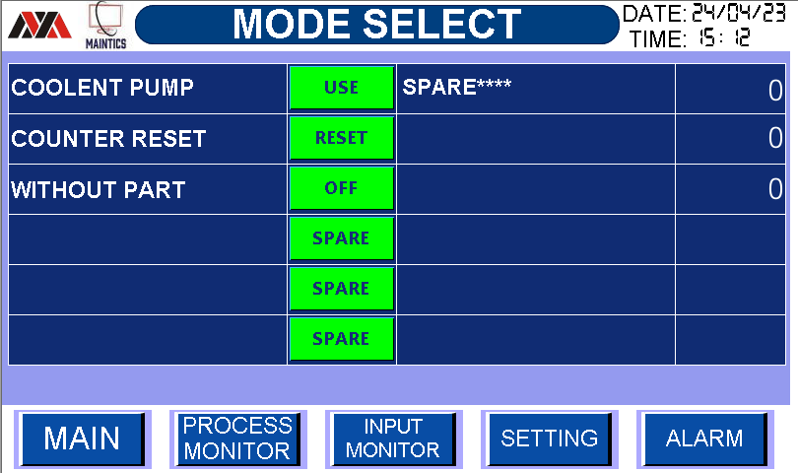
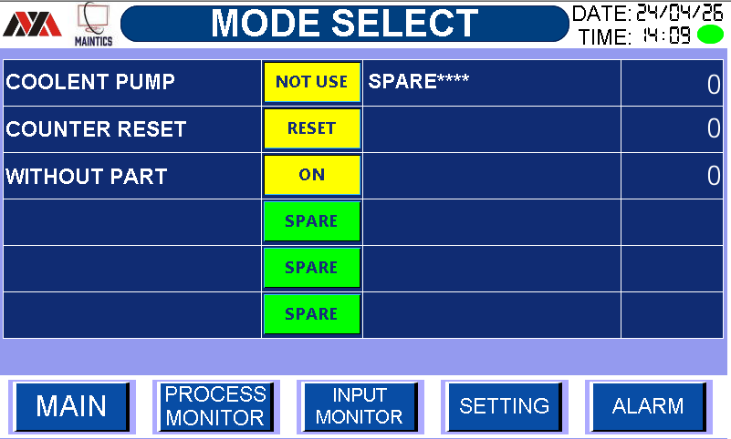





6. MODE SELECT SETTING SCREEN
Machine Settings can be done from this screen.
COOLENT PUMP ON Condition
2. COOLENT PUMP Off Condition
3. COUNTER RESET ON
WITHOUT PART OFF
WITHOUT PART TRIAL ON

Slide 15
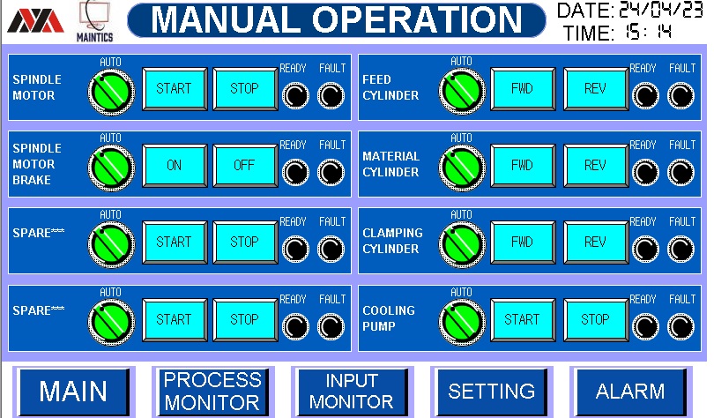

7. MANUAL OPEARTION 1 SCREEN
Manual Operation of all device can be performed using this screen
Steps for manual operation
First check Fault Light it should be Off
Now check Ready Light it should be Green
Now press Auto Manual selector switch to change mode from Auto to manual
Now Press Start Button to Start the Device
It will glow green if device is started.

Slide 16
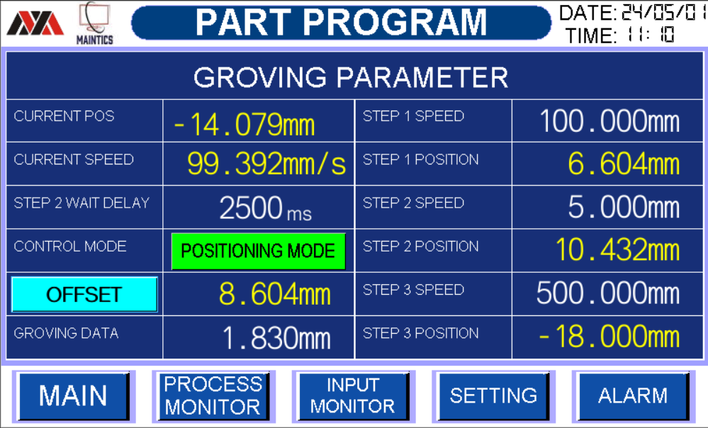





8. PART PROGRAM SCREEN
1. Here you can change grooving Program
a) WAIT DELAY VALUE (Here you Can Changr Groving
Data 1sec wait Delay Value.)
b) OFFSET VALUE (Here you can Set Offset
Material Value.)
c) GRONING DATA VALUE (Here you can set Groving
Value.)
d) STEP 1 SPEED VALUE (Here you can set the
step 1 SPEED VALUE)
e) STEP 2 SPEED VALUE (Here you can set the
step 2 SPEED VALUE)

Slide 17



8. PART PROGRAM SCREEN
1. Here you can change grooving Program
f) STEP 3 SPEED VALUE (Here you can change
step 3 Speed Value )
2. Here you can monitor POSITIONING MODE &
JOG MODE
a) Herer you can monitor
POSITION MOSE is ON
b) Here you can monitor
JOG MODE is ON

Slide 18
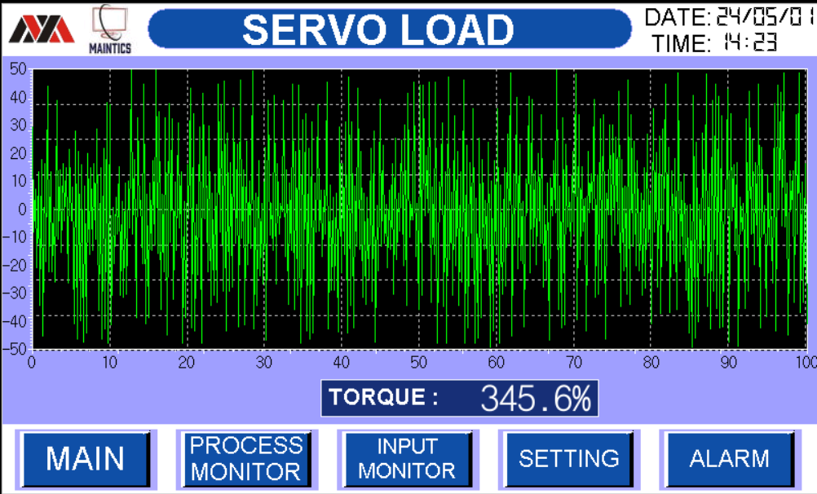
9. SERVO LOAD SCREEN
SERVO LOAD GRAPH
Here you can monitor servo Load Graphically
You Can monitor servo Troque Graphically
c) You Can monitor servo Speed Graphically.

Slide 19
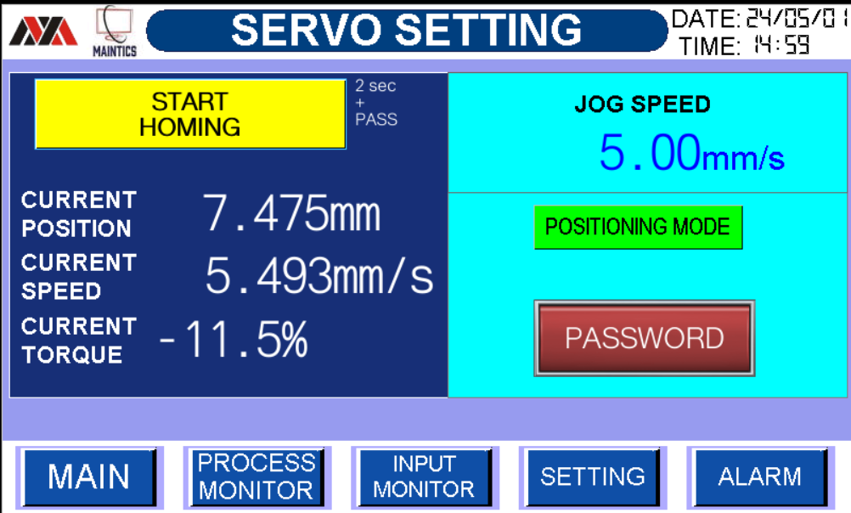

10. SERVO SETTING SCREEN
1 SERVO MOTOR HOMING STATUS
a) SERVO CURRENT OPSOTION (10.000mm)
b) SERVO CURRENT SPEED (-0.170mm/s)
c) SERVO CURRENT TORQUE (1.1%)
2 SERVO MOTOR JOG SPEED
JOG SPEED MIN MAX
(0.01mm/s) (10.00mm/s)
3 Servo Homing
Here you can enter password and Press 2 Second and servo Start homing Automatically

Slide 20
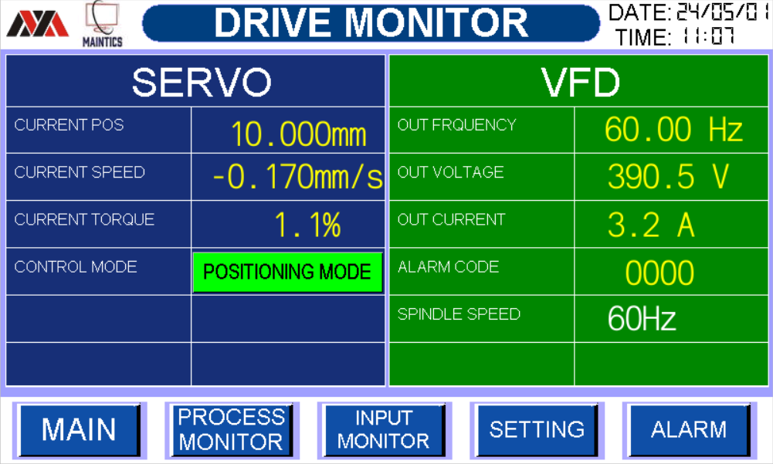

11. DRIVE MONITOR SCREEN
DRIVE MONITOR STATUS
Here you can monitor SERVO & VFD STATUS
SERVO
a) Here you can monitor servo current position.
b) Here you can monitor servo current speed.
c) Here you can monitor servo Current Torque.
VFD
a) Here you can monitor VFD Frequency.
b) Here you can monitor VFD Voltage.
c)Here you can monitor VFD Current.
d)Here you can monitor VFD Alarm Code.
2. Here you can change SPINDLE SPEED Using Hz
MIN MAX
25Hz 60Hz

Slide 21
Electrical Drawings

Slide 22
Troubleshooting Guide

Slide 23
1. HMI ALARM GUIDE

Slide 24
2. MACHINE AUTO RUNNING FLOW
STOP
START PB
MACHINE HOME
NO
Check Reed Switch
X20, X22 if NO
YES
MACHINE AUTO
NO
Check Manual Screen
If NO
YES
MACHINE NORMAL
Check Alarm Screen
For any alarm reset alarm before if NO
NO (FAULT)
YES
AUTO RUNNING

Slide 25
BOM (BILL OF MATERIAL)

Slide 26
1. LIST OF ITEMS USED

